Slide 1
Assignment 4
Using a new Framework

Slide 2
Why Flask & not Django?
Flask
Microframework
Less out-of-the-box features
Easy to setup
Fast
Jinja2 templating engine
django
MVC Framework
More feature rich
Slower
More widely used

Slide 3

What it takes to install flask
Install python
Pip install flask

Slide 4

ORM used - Sqlalchemy
Easy to install
Pip install sqlalchemy

Slide 5

ORM database management system
Postgresql
Pgadmin4 –postgresql tool
Allows looking at database schemas

Slide 6
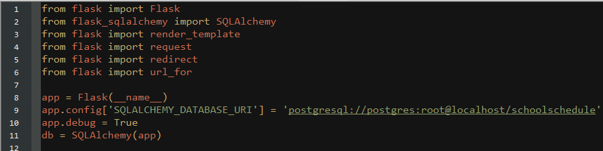
Simple setup
only need one python file
Import all necessary features

Slide 7
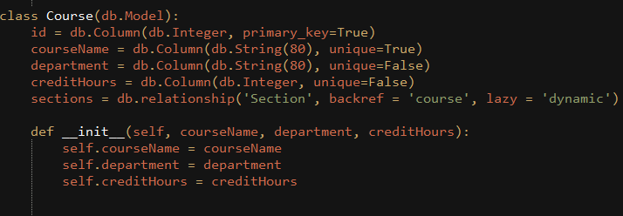
How to create tables
Easy to read and understand

Slide 8
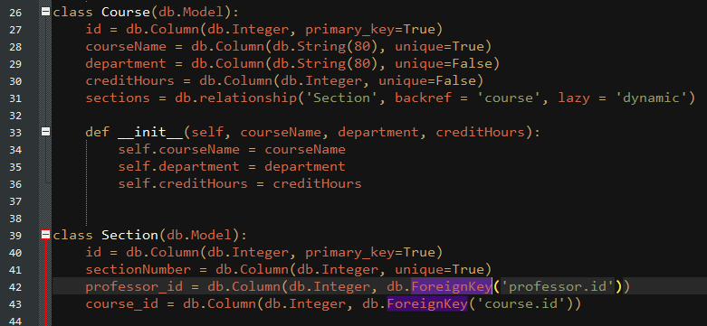
Setup primary and foreign keys

Slide 9
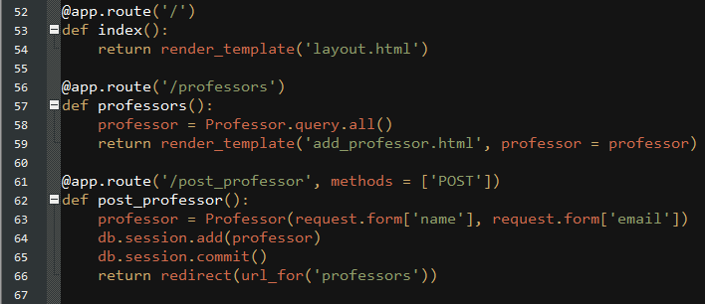
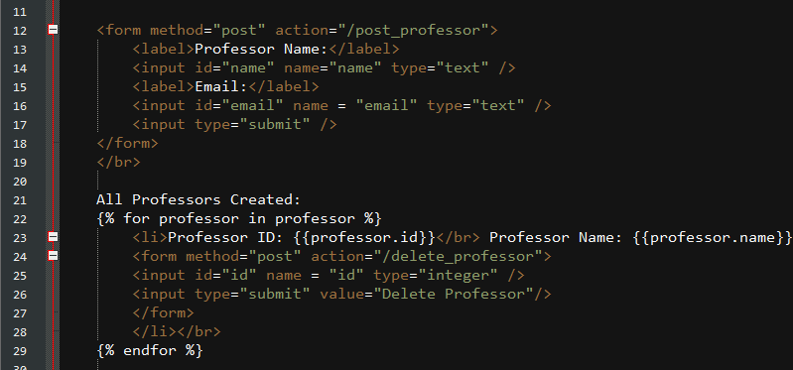
Creating routes

Slide 10
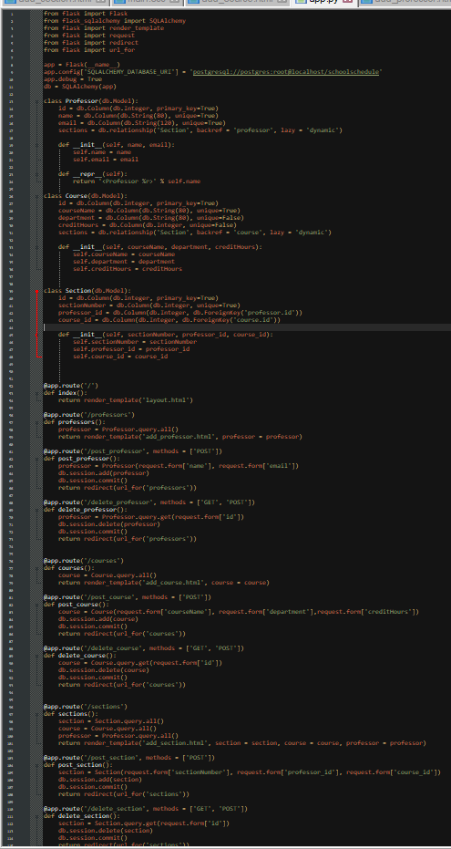
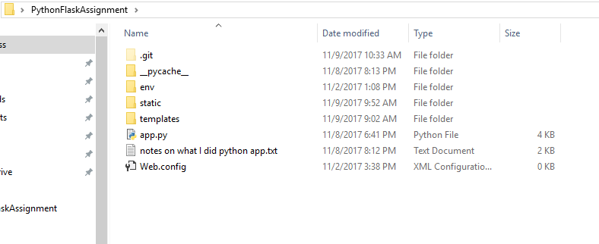
THE END

